Slide 1

LINUX
THE vi EDITOR

Slide 2
CONTENT
vi Basics
Modes of vi editor
Input Mode
Ex Mode
Navigation
Editing Text

Slide 3
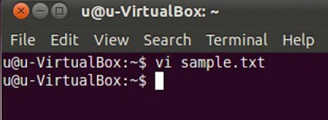
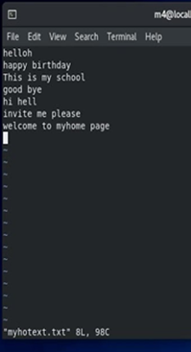
vi BASICS
Invoking vi editor
vi <filename>
In all probability, the file doesn’t exist, and vi presents you a full screen with the filename shown at the bottom with the qualifier, [New file].
The cursor is positioned at the top and all remaining lines of the screen show ~. They are non-existent lines.
The last line is reserved for commands that you can enter to act on text.
When file is opened in a vi editor, by default it will be opening in a command mode.
To enter text, you must switch to the input mode. First press the key i, and moved to input mode and ready to input text.
To save the entered text, you must switch to the execute mode by entering a : which shows up in The last line.

Slide 4
THE THREE MODES OF vi EDITOR
COMMAND MODE
When user starts up vi editor, user are in command mode. The default mode of the editor where every key pressed is interpreted as a command to run on text.
This mode allows to copy, delete text, edit files and to move to any other modes. When keys are pressed in this mode it simply performs functions, it doesn’t displayed on the screen.
Some of the commands are : To delete a text command x is used, to delete entire line use dd command, to put the character use P or p command, to yank the text use y command, use of yy copies entire line, to undo the recent actions use u command.

Slide 5
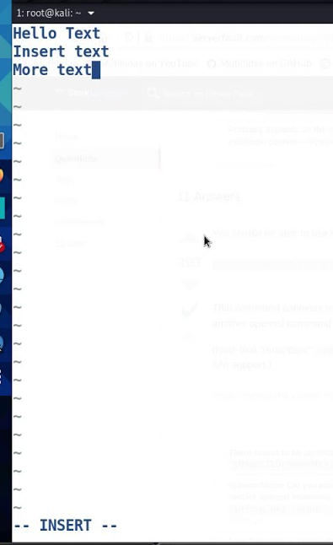
THE THREE MODES OF vi EDITOR
INPUT MODE
Every key pressed after switching to this mode actually shows up as text. This mode is invoked by pressing one of the keys among i a I A o O r R s S.
Command | Function
i I | Inserts text before the current character Inserts text at the beginning of current line
a A | Appends text after the current character Appends text at the end of the current line
o O | Opens a line under the current line and inserts supplied text in it. Opens a line above the current line and inserts supplied text in it.
r R | Replaces the current character at the cursor with the new one Replaces a set of characters with a new set of characters
s S | Substitute the current character with the supplied text Substitute the current line with the supplied text

Slide 6
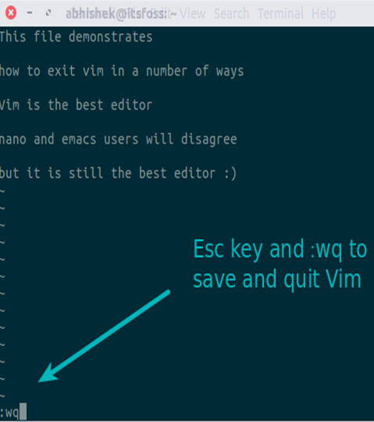
THE THREE MODES OF vi EDITOR
EX MODE (LAST LINE MODE)
This mode is also known as the last-line mode and allows the user to use the command in the bottom line in vi screen.
This mode is used to handle files (like saving) and perform substitution.
Press : in the command mode invokes this mode and cursor moves to the bottom of the screen.
The commands entered in this mode are displayed in the command line, the last line. Anything entered in front of colon : prompt it is taken as an ex command.

Slide 7
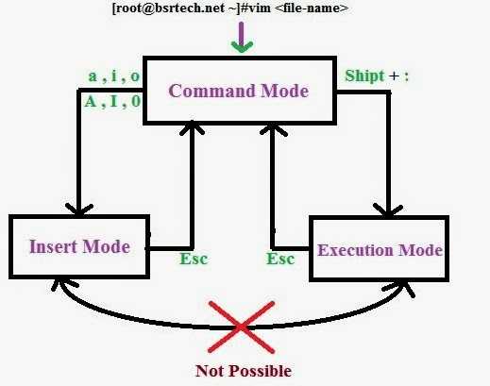
SWITCHING BETWEEN
MODES
When the user starts up the vi editor, user is in command mode.
From command mode user can enter to input mode by pressing I,i,a,A,s,S,R,r,O,o commands.
From input mode user can move back to command mode by pressing [esc].
From command mode, the ex mode is invoked by pressing :.

Slide 8
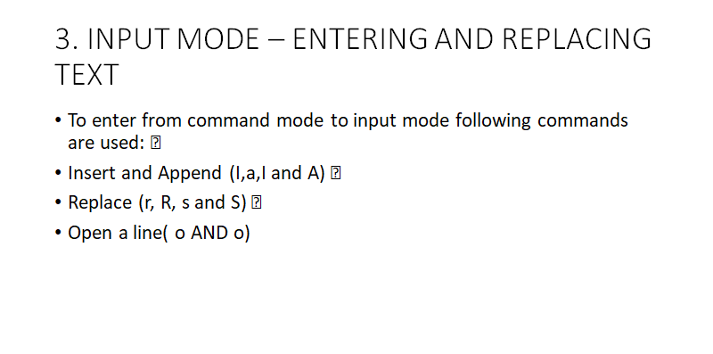

Slide 9
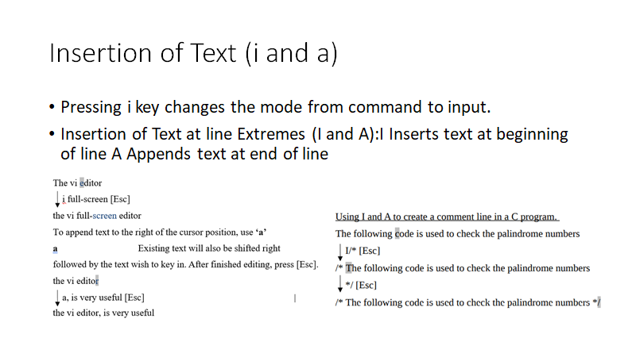

Slide 10
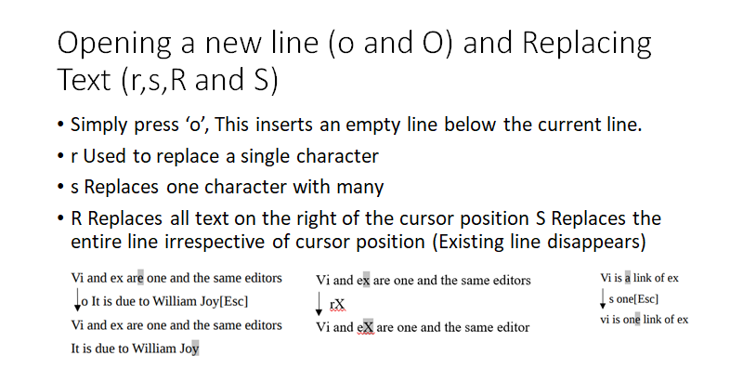

Slide 11
SUMMARY OF INPUT MODE COMMANDS
Command | Function
i I | Inserts text before the current character Inserts text at the beginning of current line
a A | Appends text after the current character Appends text at the end of the current line
o O | Opens a line under the current line and inserts supplied text in it. Opens a line above the current line and inserts supplied text in it.
r R | Replaces the current character at the cursor with the new one Replaces a set of characters with a new set of characters
s S | Substitute the current character with the supplied text Substitute the current line with the supplied text

Slide 12
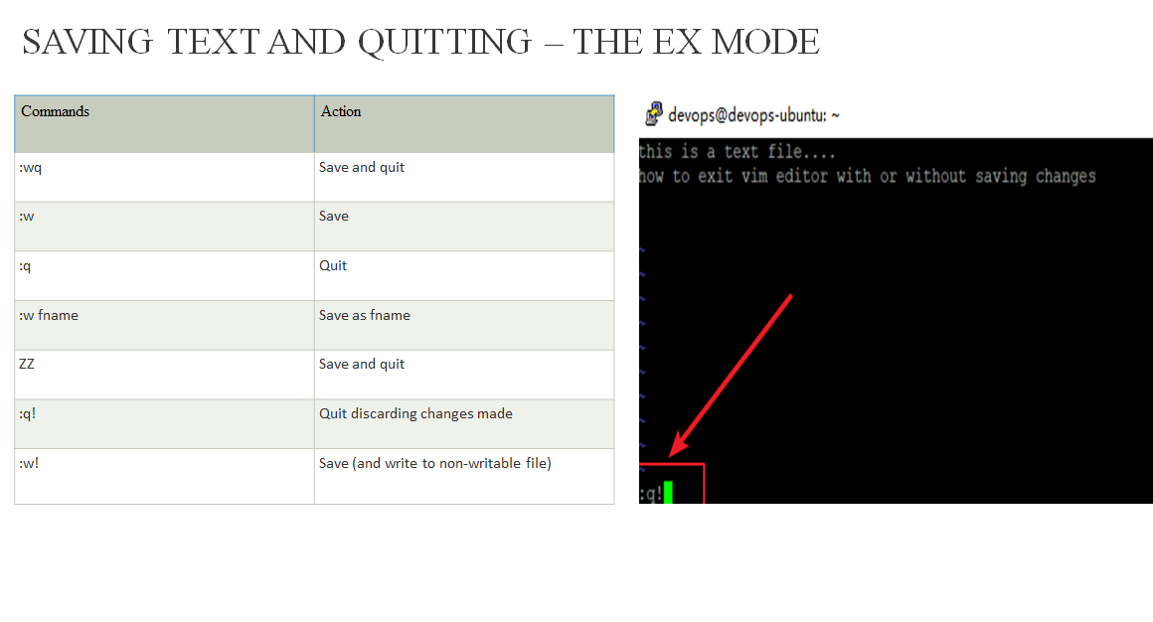

Slide 13
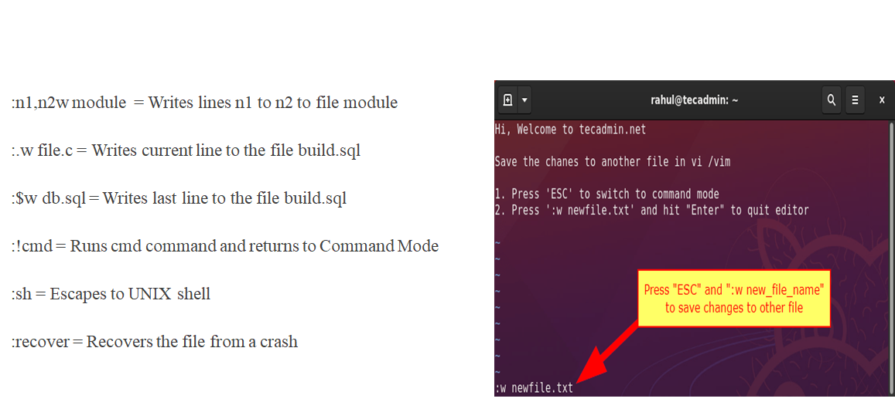

Slide 14
NAVIGATION
Command | Meaning | Direction
k | moves cursor up | UP
j | Moves cursor down | DOWN
h | Moves the cursor left | LEFT
l | Moves the cursor right | RIGHT
Vi provides the keys h,j,k and l to move the cursor in the four directions.

Slide 15
Word Navigation (b,e and w)
There are 3 basic navigation commands:
b Moves back to beginning of word
e Moves forward to end of word
w Moves forward to beginning of word
Moving to Line Extremes
0 or | 30| moves cursor to column 30
$ moves to the end of the current line

Slide 16
Scrolling, Moving text, Deleting text, Coping text
Command | Function
ctrl-f | Scrolls one page forward
ctrl-b | Scrolls one page backward
ctrl-d | Scrolls half page forward
ctrl-u | Scrolls half page backward
20G | Moves the cursor to the beginning of the line number 20
1G | Moves the cursor to the beginning of the very first line
G | Moves the cursor to the beginning of the last line
b | Moves back to the beginning of a word
e | Moves forward to the end of a word
Ctrl-g | To know the current line number

Slide 17
Command | Function
X | Deletion of the left character
4X | Deletion of the current character as well as three characters from the right side
dd | Entire lines can be deleted
y | Copy the single character
yy | Copy the entire line
10yy | Copy the current line & below 9 line

Slide 18

THANK YOU……………….
HACKED
BY
DARSHAN KN
EASHAN CHAMOLI
ADITYA
GOWTHAM
JAI

